Slide 1

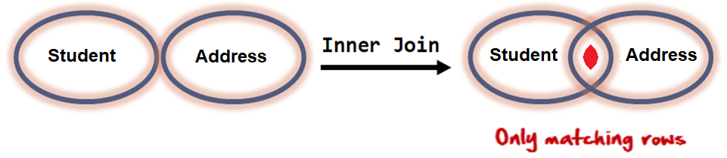
Inner/ equi Join
The inner join is one of the most commonly used joins in SQL. The inner join clause allows you to query data from two or more related tables.
INNER JOIN performs a JOIN against equality or matching column(s) values of the associated tables. An equal sign (=) is used as comparison operator in the ON clause to refer equality.
EQUI JOIN performs a JOIN against equality or matching column(s) values of the associated tables. An equal sign (=) is used as comparison operator in the WHERE clause to refer equality.
Infoway Technologies, 3rd Floor Commerce Centre, Rambaug Colony, Paud Road Pune 411038

Slide 2
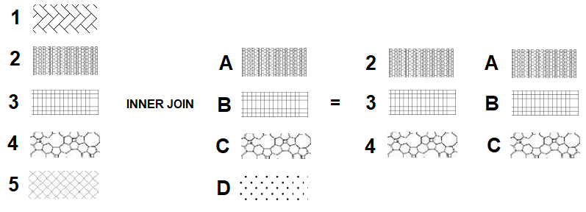
Use an INNER JOIN when you need to match rows from two tables. Rows that match remain in the result, those that don't are rejected. The match condition is commonly called the join condition. Inner/ equi Join returns rows when there is at least one match in both tables.
The following table illustrates the inner join of two tables T1 (1,2,3,4,5) and T2 (A,B,C,D). The result includes rows: (2,A), (3,B),a dn (4,C) as they have the same patterns.
Infoway Technologies, 3rd Floor Commerce Centre, Rambaug Colony, Paud Road Pune 411038

Slide 3
Difference between Natural JOIN and INNER JOIN
NATURAL JOIN | INNER JOIN
Natural Join joins two tables based on same attribute name and datatypes. | Inner Join joins two table on the basis of the column which is explicitly specified in the ON clause.
In Natural Join, The resulting table will contain all the attributes of both the tables but keep only one copy of each common column | In Inner Join, The resulting table will contain all the attribute of both the tables including duplicate columns also
In Natural Join, If there is no condition specifies then it returns the rows based on the common column | In Inner Join, only those records will return which exists in both the tables
SYNTAX: SELECT * FROM table1 NATURAL JOIN table2; | SYNTAX: SELECT * FROM table1 INNER JOIN table2 ON table1.Column_Name = table2.Column_Name;
Infoway Technologies, 3rd Floor Commerce Centre, Rambaug Colony, Paud Road Pune 411038

Slide 4
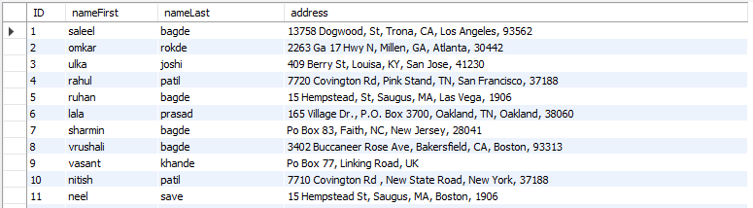
equi join
syntex
SELECT column-list from <table_references>, <table_references> WHERE table1.column-name = table2.column-name
SELECT s.ID, s.nameFirst,s.nameLast, a.address FROM student s, student_address a WHERE s.ID = a.studentID;

Slide 5
inner join
syntex
SELECT column-list from <table_references> [INNER] JOIN <table_references> ON table1.column-name = table2.column-name
SELECT s.ID, s.nameFirst,s.nameLast, a.address FROM student s INNER JOIN student_address a ON s.ID = a.studentID;

